Slide 1
How To Download and Install Zoom

Slide 2
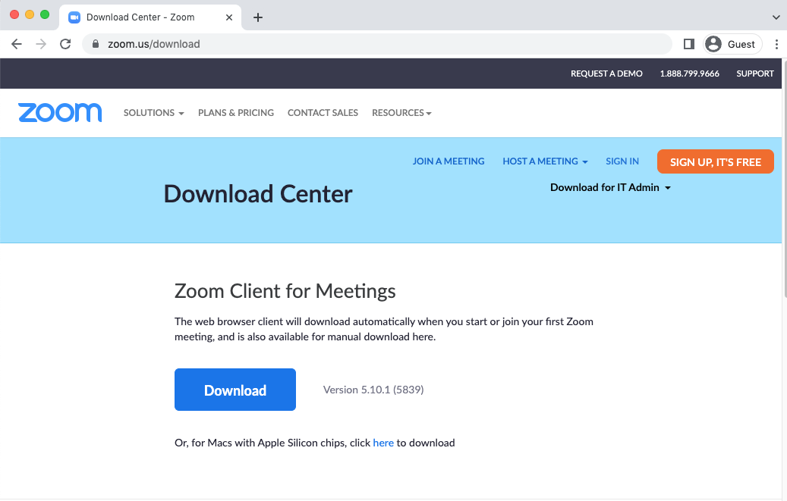
You should open the zoom.us/download page via a web browser.
uzem.bilgi.edu.tr
lms.support.bilgi.edu.tr
lms.support@bilgi.edu.tr

Slide 3
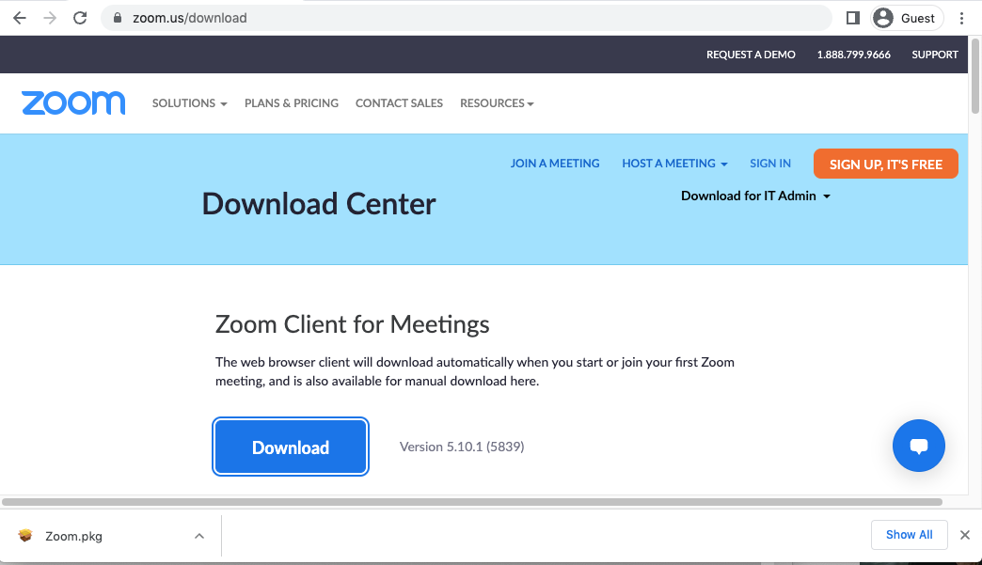
Click the Download button under Zoom Client for Meetings on the page that opens and you should run the downloaded ZoomInstaller.exe file.
ZoomInstaller.exe
uzem.bilgi.edu.tr
lms.support.bilgi.edu.tr
lms.support@bilgi.edu.tr

Slide 4
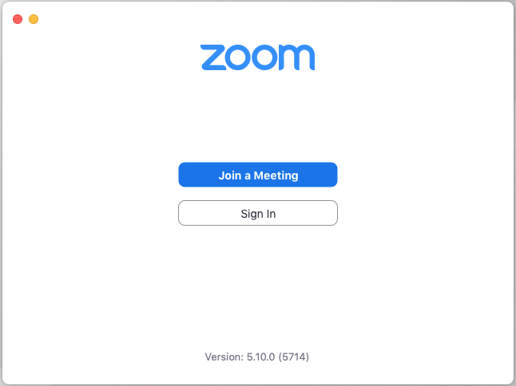
When installation process is complete, Zoom application will open on your screen.
uzem.bilgi.edu.tr
lms.support.bilgi.edu.tr
lms.support@bilgi.edu.tr

