Slide 1
COURSE EXPORT

Slide 2
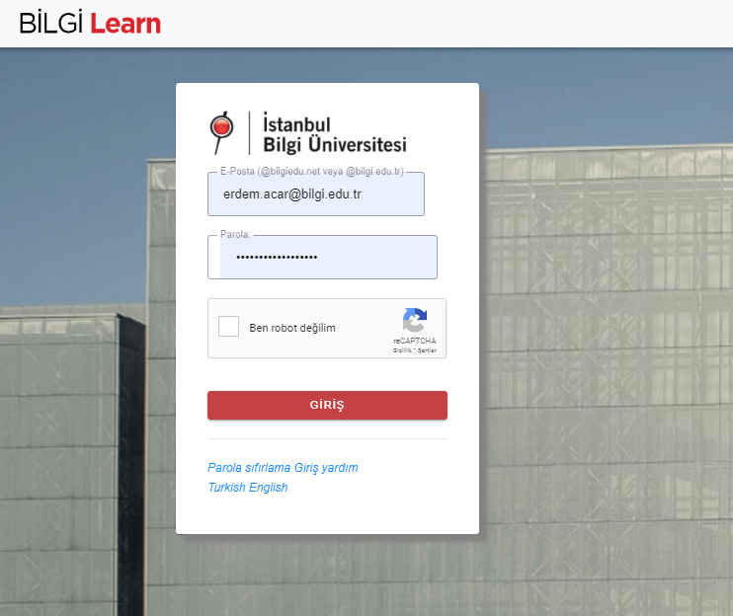
The LMS address where you can view archived old courses is archlearn.bilgi.edu.tr You can log in with your Bilgi account here. Your courses from previous semesters will be stored on this LMS system.
uzem.bilgi.edu.tr
lms.support.bilgi.edu.tr
lms.support.bilgi.edu.tr

Slide 3
To export the entire course as a package, follow these steps. Click on the settings button on the course page, then select 'Backup'.
uzem.bilgi.edu.tr
lms.support.bilgi.edu.tr
lms.support.bilgi.edu.tr

Slide 4
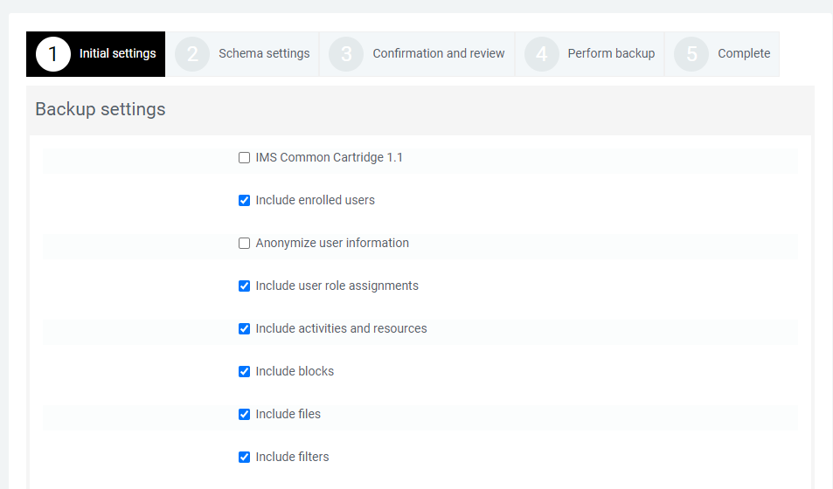
"Exclude enrolled users" option, continue by disabling it.
uzem.bilgi.edu.tr
lms.support.bilgi.edu.tr
lms.support.bilgi.edu.tr

Slide 5
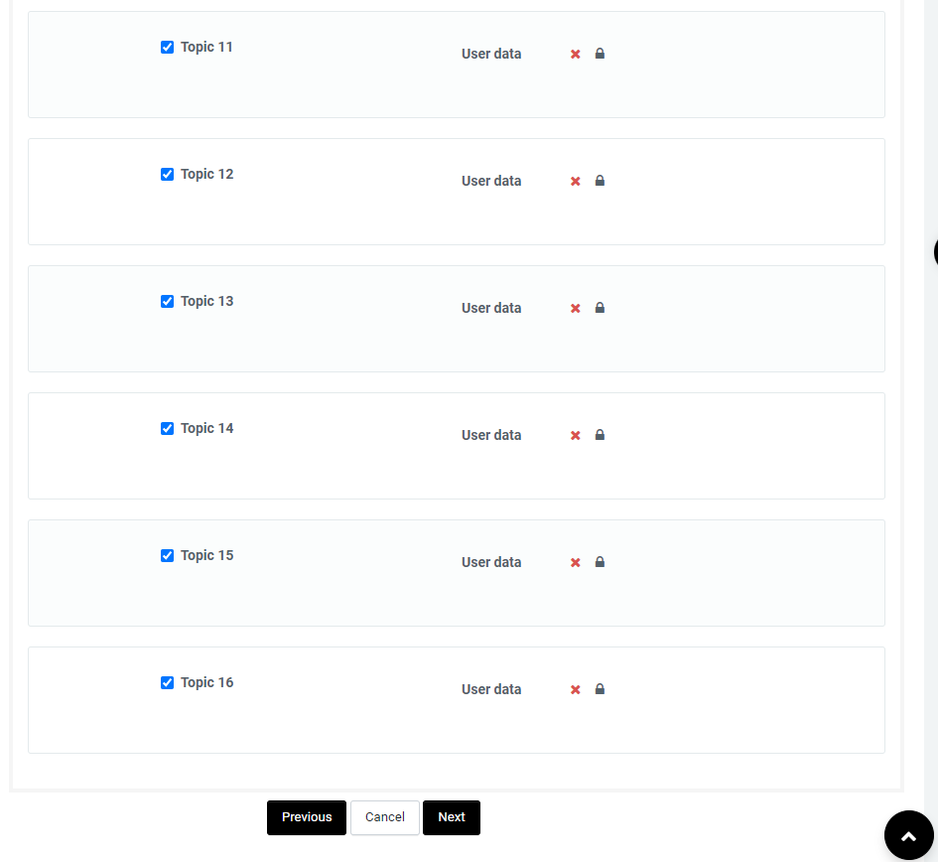
Please make sure that all fields are selected, and click the "Next" button.
uzem.bilgi.edu.tr
lms.support.bilgi.edu.tr
lms.support.bilgi.edu.tr

Slide 6
Rename your file in the Filename field and complete the process by clicking the "Perform backup" button at the bottom of the page.
uzem.bilgi.edu.tr
lms.support.bilgi.edu.tr
lms.support.bilgi.edu.tr

Slide 7
After your process is completed, click the "Continue" button.
uzem.bilgi.edu.tr
lms.support.bilgi.edu.tr
lms.support.bilgi.edu.tr

Slide 8
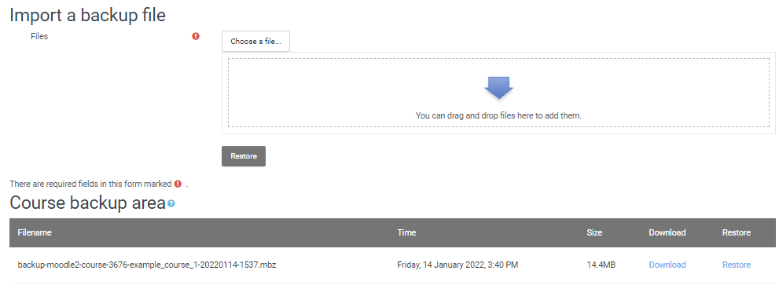
Download your backed-up course by clicking on the "Download" section shown in the image to save it to your computer.
uzem.bilgi.edu.tr
lms.support.bilgi.edu.tr
lms.support.bilgi.edu.tr

