Slide 1
COURSE IMPORT

Slide 2
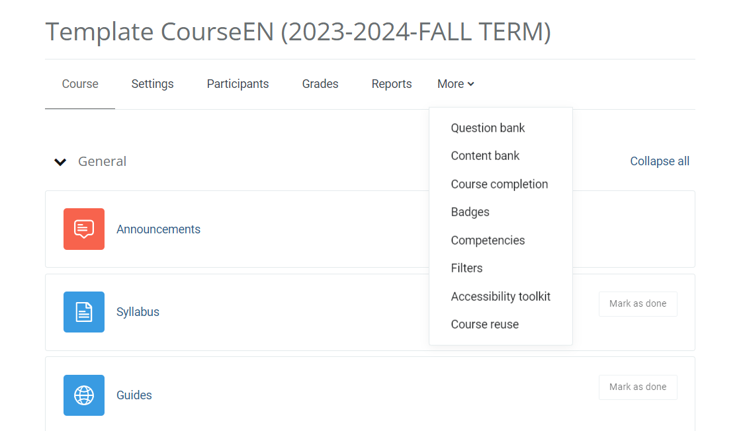
To import the backup file into the course, click on the ‘Course reuse' button shown in the image.
uzem.bilgi.edu.tr
lms.support.bilgi.edu.tr
lms.support.bilgi.edu.tr

Slide 3
"After clicking on the 'Import' tab, select the 'Restore' section."
After clicking on the 'Import' tab, select the 'Restore' section.
uzem.bilgi.edu.tr
lms.support.bilgi.edu.tr
lms.support.bilgi.edu.tr

Slide 4
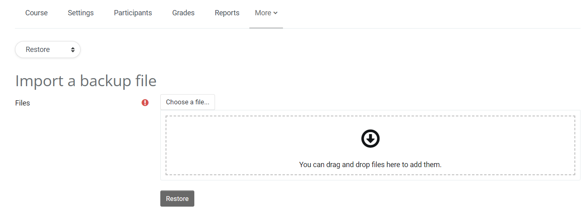
Upload the export file that you have on your computer to this area and click the 'Restore' button.
uzem.bilgi.edu.tr
lms.support.bilgi.edu.tr
lms.support.bilgi.edu.tr

Slide 5
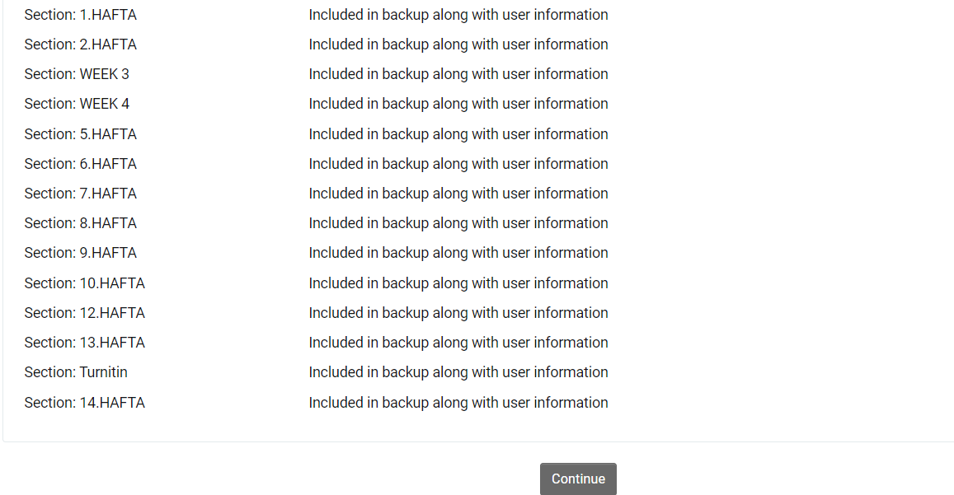
You will see the information about the export file, continue the process by clicking the 'Continue' button at the bottom of the page.
uzem.bilgi.edu.tr
lms.support.bilgi.edu.tr
lms.support.bilgi.edu.tr

Slide 6
In the 'Restore this course' section, select 'Merge the backup course into this course' and continue by clicking the 'Next' button in this section.
uzem.bilgi.edu.tr
lms.support.bilgi.edu.tr
lms.support.bilgi.edu.tr

Slide 7
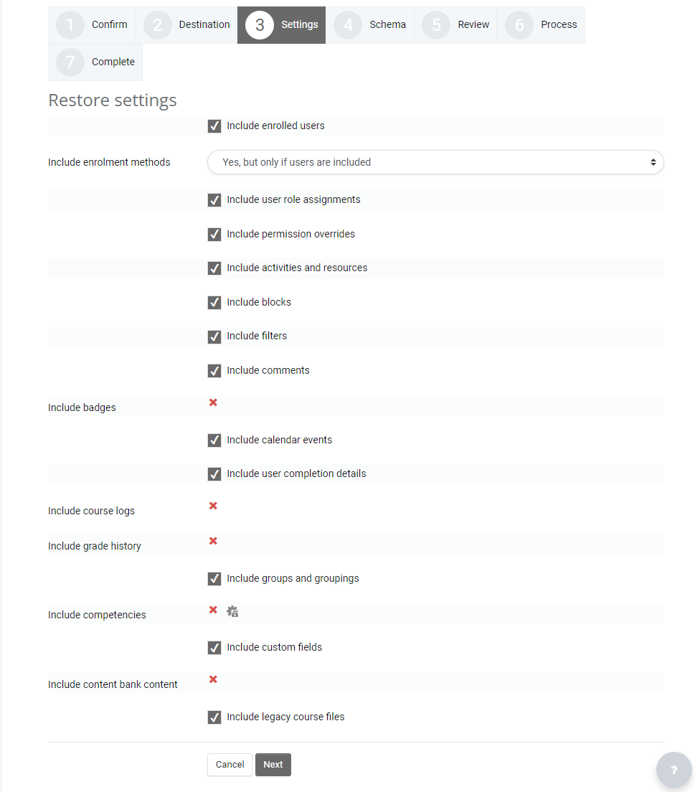
In the next step, make sure all the checkboxes are marked and click the 'Next' button.
uzem.bilgi.edu.tr
lms.support.bilgi.edu.tr
lms.support.bilgi.edu.tr

Slide 8
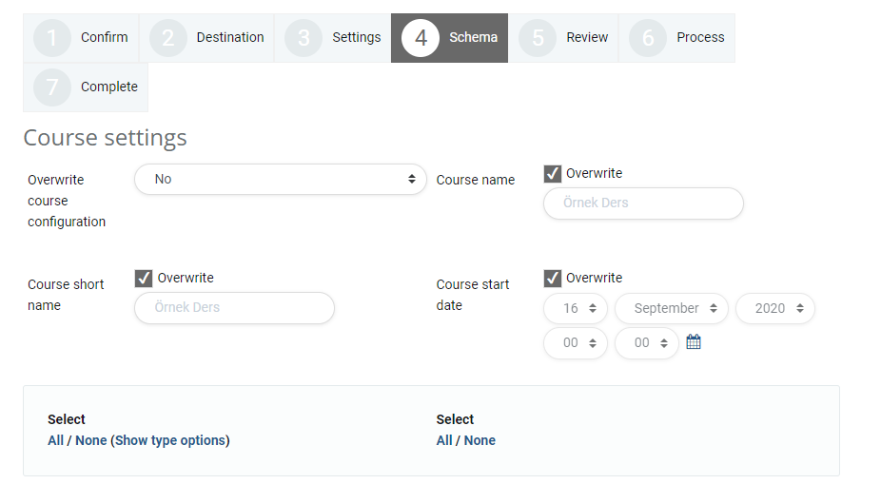
After reviewing the course contents, scroll down to the bottom of the page and click the 'Next' button.
uzem.bilgi.edu.tr
lms.support.bilgi.edu.tr
lms.support.bilgi.edu.tr

Slide 9
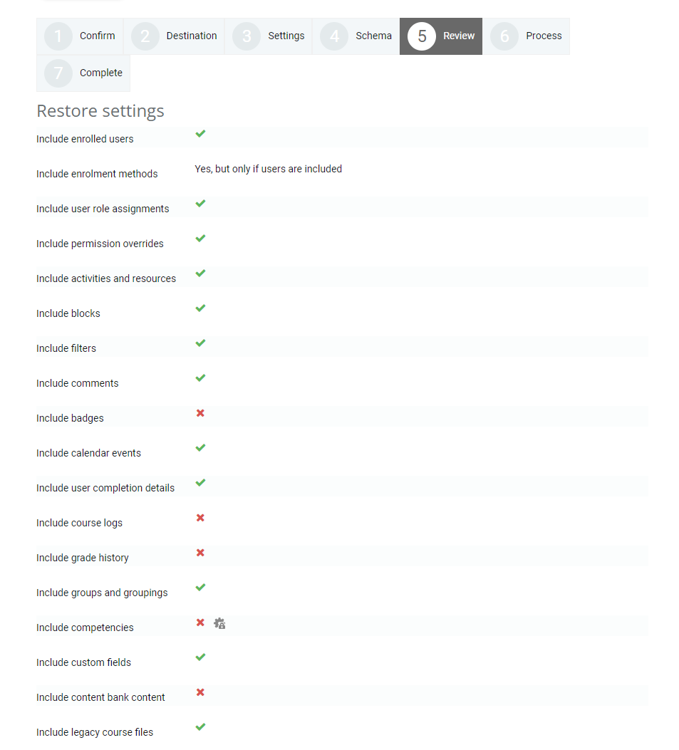
"The system shows us a preview page. After completing the preview, click the ‘Perform Restore' button at the bottom of the page to finish the process."
uzem.bilgi.edu.tr
lms.support.bilgi.edu.tr
lms.support.bilgi.edu.tr

